Slide 1

The
Programming
Language
Ana Garcia, Gabriell Go, Daniel Hong

Slide 2
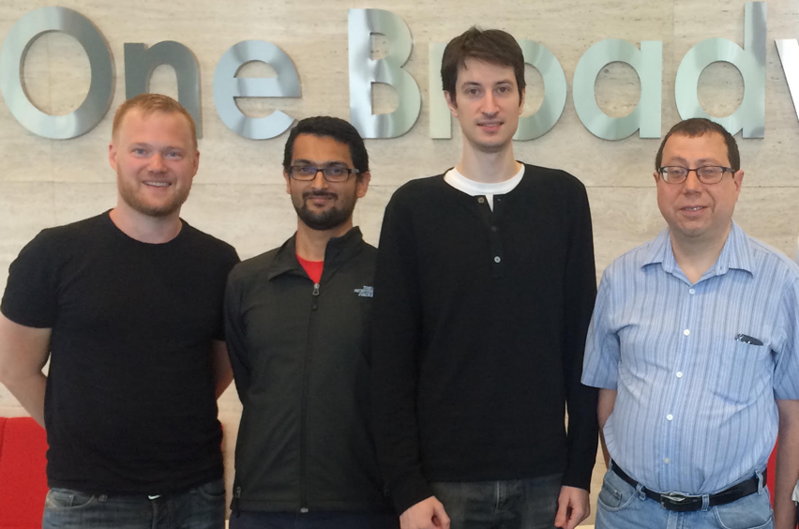
History
Julia was started in 2009 by Stefan Karpinski, Viral B. Shah, Jeff Bezanson, and Alan Edelman at MIT.
It was publically announced in 2012, and version 1.0 was released in 2018.
Because it was made by a group of computer scientists and applied mathematicians, Julia was made with scientific/mathematical computing in mind.

Slide 3



Why was it made?
The creators of Julia had a clear goal in mind: to solve the “two-language problem” in scientific computing — where researchers prototype in high-level languages but rewrite performance-critical code in lower-level languages like C or Fortran.

Slide 4
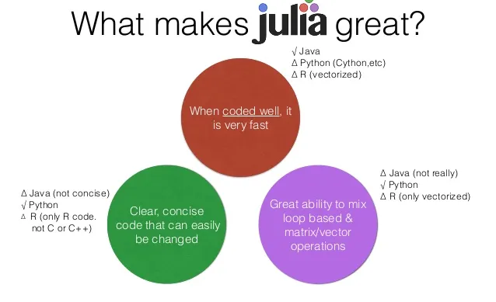
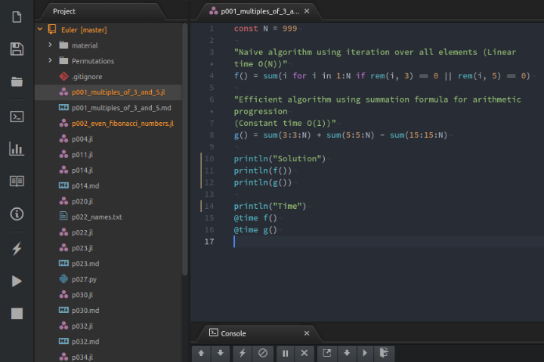
Pros
Speed (thanks to JIT compiler)
Clean and readable syntax
Great for math and scientific computing
Strong support for parallel computing
Powerful package ecosystem for science

Slide 5
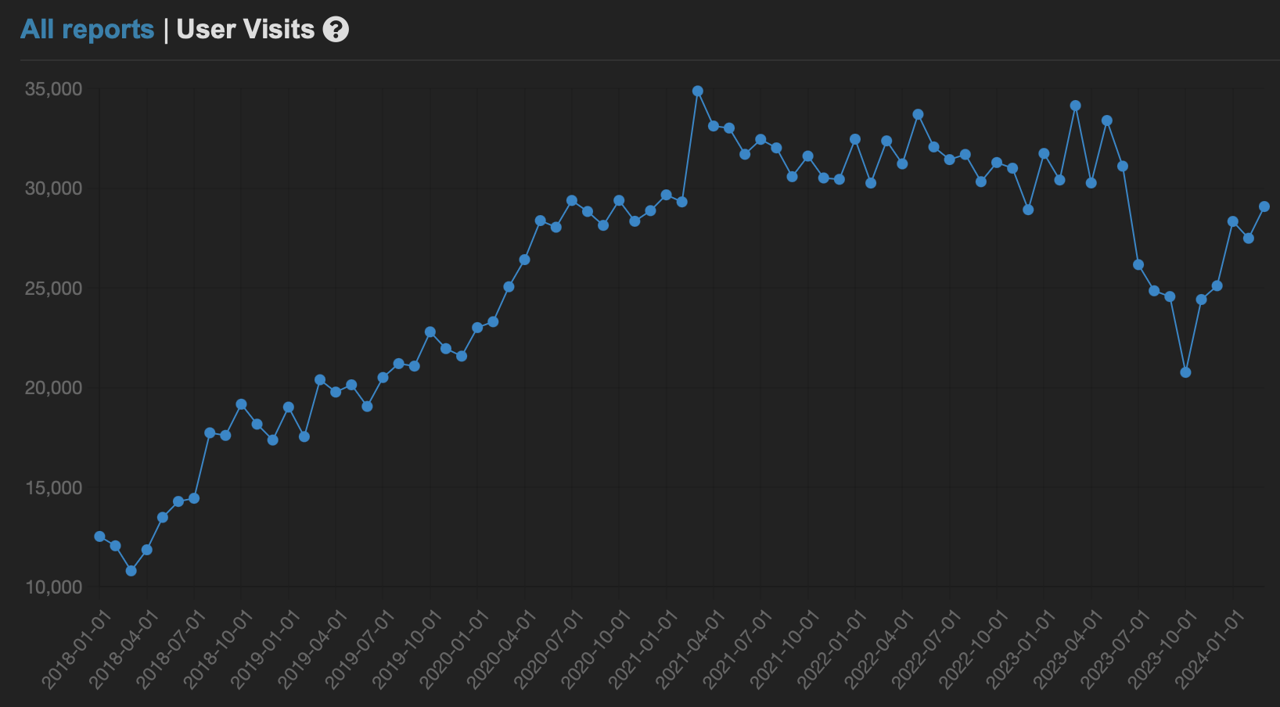
Cons
First-run compilation delay due to JIT compiler
Smaller ecosystem than Python
Deployment can be complex
Learning performance optimization takes time and practice

Slide 6
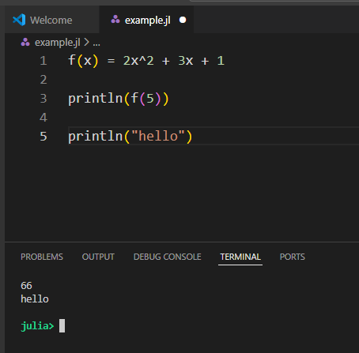
Example 1
No need to write return
No need for curly braces
Print statement is just println
Easy math
Notes:
Julia lets you write math like actual math

Slide 7
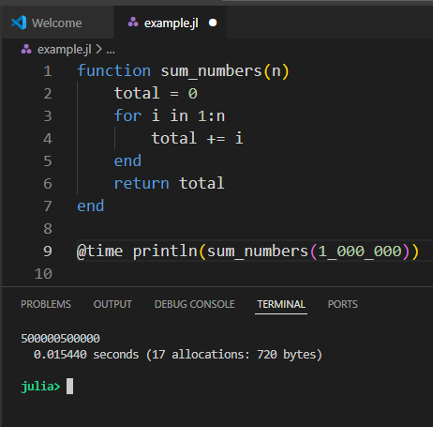
Example 2
Simple loop
No tricks
Still very fast
Notes:
I used @time to show how long it took
Julia doesn’t require special tricks to be fast. Even basic loops perform well

Slide 8
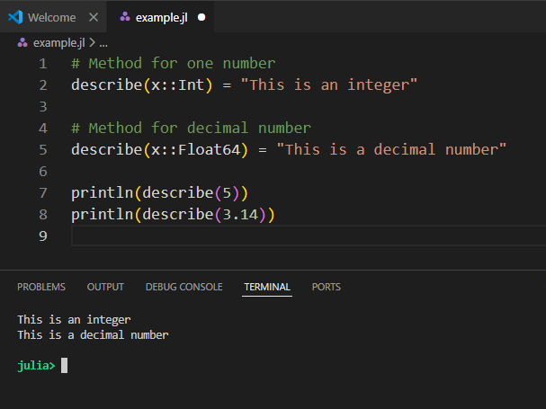
Example 3
Multiple Dispatch is a core feature
Same function name
Different behaviour based on type
Notes:
“Julia automatically chooses the correct method depending on the data type.
That’s called multiple dispatch, and it’s one of Julia’s biggest strengths

Slide 9
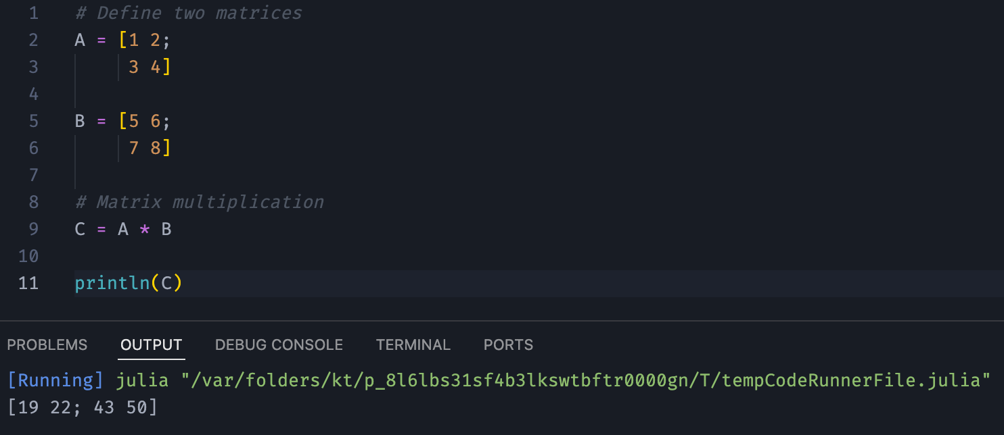
Example 4
Provides built in matrices functionality as well as linear algebra

